Slide 1

FOOD DELIVERY SYSTEM
K. ANUSHA 202P1A0565 Under the Guidance of
N. AKHILANDESWARI 202P1A0589 MR. Gopireddy Sreenivasa Reddy
P. SANDHYA 202P1A05A4 Associate Professor
P. ANUSHA 202P1A05A5 Department of CSE
Department of Computer Science and Engineering
Chaitanya Bharathi Institute of Technology
Vidya Nagar, Proddatur, YSR Kadapa (Dist.), Andhra Pradesh- 516360

Slide 2
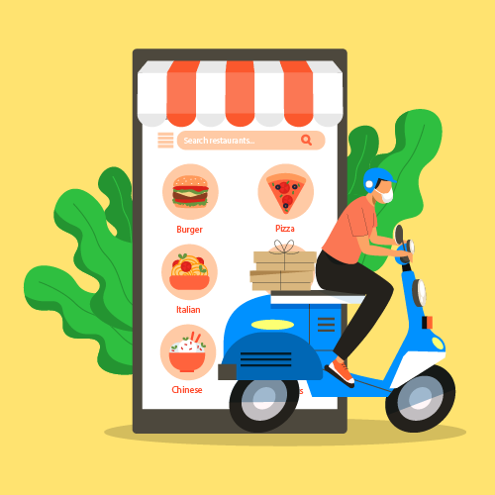
CONTENT
Introduction
objectives
Abstract
Existing System
Existing System Disadvantages
Proposed System
Proposed System Advantages
Software Requirements
Hardware Requirements
Architecture
Result
Conclusion

Slide 3
INTRODUCTION
In today's fast-paced world, the demand for convenient and efficient food ordering solutions has surged, leading to the development of innovative digital platforms such as the Food Order web application. This introduction explores the evolution of online food ordering services and the growing significance of web applications in facilitating seamless transactions between consumers and restaurants. The Food Order web application serves as a user-friendly interface that empowers users to browse, select, and order food from a diverse range of restaurants with ease. By leveraging advanced technologies and intuitive design principles, this application aims to redefine the online food ordering experience, offering customers unparalleled convenience and choice while enabling restaurants to expand their reach and enhance customer engagement. Through this introduction, we delve into the key features and benefits of the Food Order web application, highlighting its potential to revolutionize the food delivery industry and meet the evolving needs of modern consumers.

Slide 4
OBJECTIVES
The objective of the Food Delivery system is to provide users with a convenient and efficient platform for ordering food online. By offering a user-friendly interface, real-time order tracking, and secure payment options, the application aims to streamline the food ordering process and enhance user satisfaction. Additionally, the application seeks to support restaurants by providing them with a platform to showcase their menus and reach a broader customer base, ultimately promoting growth and success in the food industry.

Slide 5
ABSTRACT
The Food Order web application is a digital platform designed to streamline the process of ordering food online. Users can browse through a variety of restaurants, view menus, place orders, and make payments conveniently from their devices. The application offers a user-friendly interface, enabling seamless navigation and a smooth ordering experience. Key features include real-time order tracking, customizable preferences, and secure payment options. This web application caters to the growing demand for convenient food delivery services, providing customers with access to a wide range of culinary options while offering restaurants a platform to showcase their offerings and expand their customer base. With its intuitive design and robust functionality, the Food Order web application aims to revolutionize the way people order food online, enhancing convenience, choice, and satisfaction.

Slide 6
EXISTING SYSTEM
The existing system for the Food Order web application involves traditional methods of ordering food, such as phone calls or visiting restaurants in person. These methods often lack convenience and efficiency, leading to longer wait times and limited menu access. The Food Order web application seeks to address these limitations by providing a digital platform for streamlined online ordering and delivery services.

Slide 7
EXISTING SYSTEM DISADVANTAGES
Price is high
Limited menu
Data maintenance is difficult.
Food may get cold
High delivery charges

Slide 8
PROPOSED SYSTEM
The proposed system is a comprehensive food ordering web application offering a user-friendly interface for browsing restaurants, viewing menus, and placing orders online. Key features include real-time order tracking, customizable preferences, and secure payment options. This system aims to streamline the food ordering process, enhance user experience, and facilitate seamless transactions for both customers and restaurants.

Slide 9
PROPOSED SYSTEM ADVANTAGES
Convenience
Enhanced User Experience
Increased Efficiency
Flexibility and scalability
Increased satisfaction

Slide 10
HARDWARE REQUIREMENTS
Servers
Database Servers
Computing Devices
Processor: Intel i5
RAM: 4GB
Hard Disk: 500 GB

Slide 11
SOFTWARE REQUIREMENTS
Operating System: Windows95/98/2000/XP
Application Server: Tomcat 7.0
Front End: HTML, CSS
Scripts: JavaScript.
Backend Language: Java
Database: MySQL 6.0
IDE: IntelliJ and Visual Studio Code

Slide 12
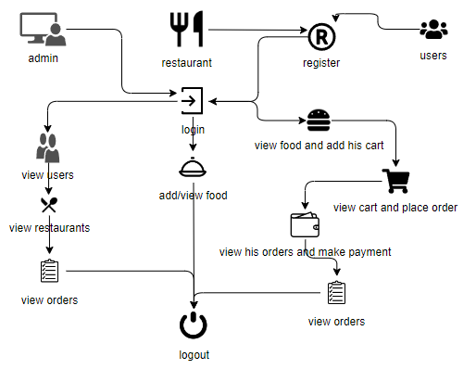
ARCHITECTURE

Slide 13
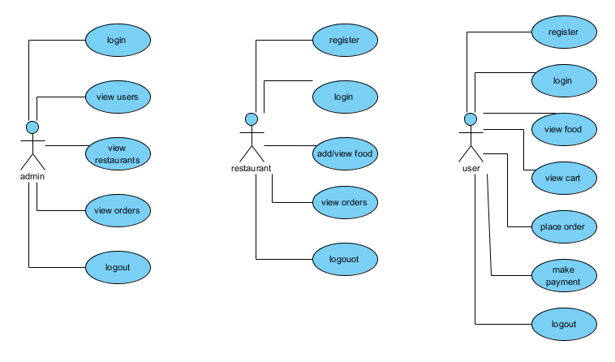
USE CASE DIAGRAM

Slide 14
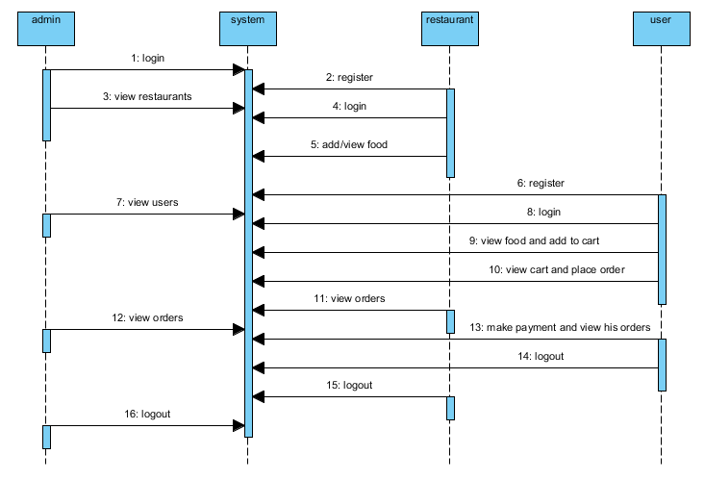
SEQUENCE DIAGRAM

Slide 15
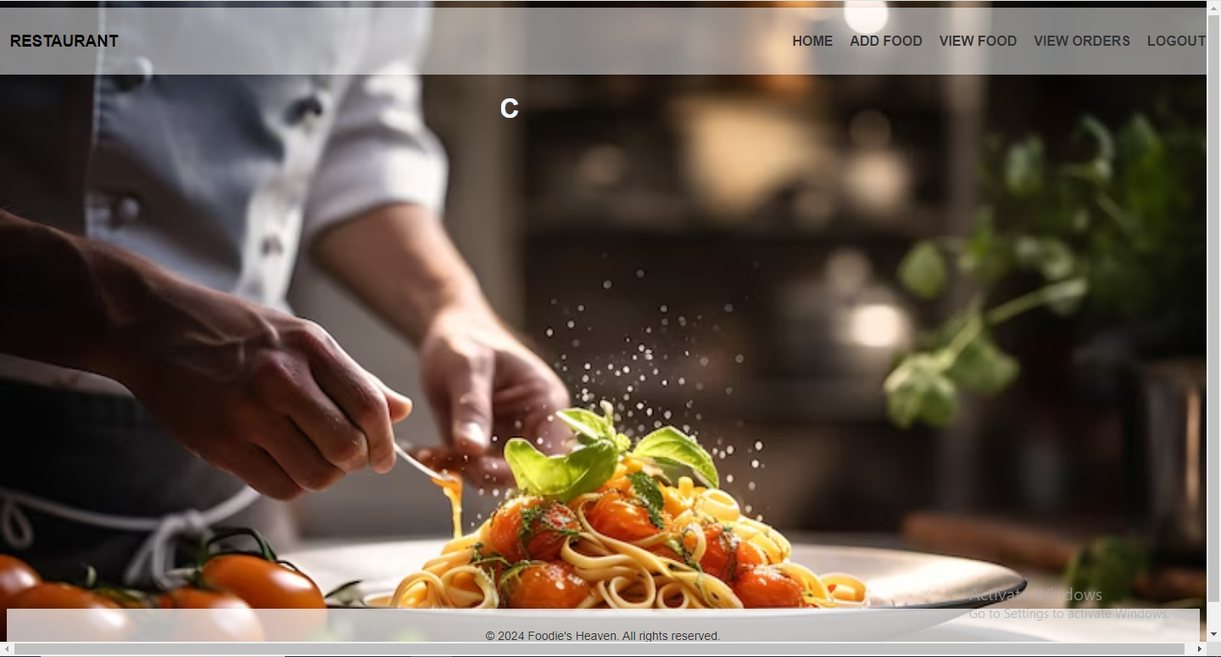
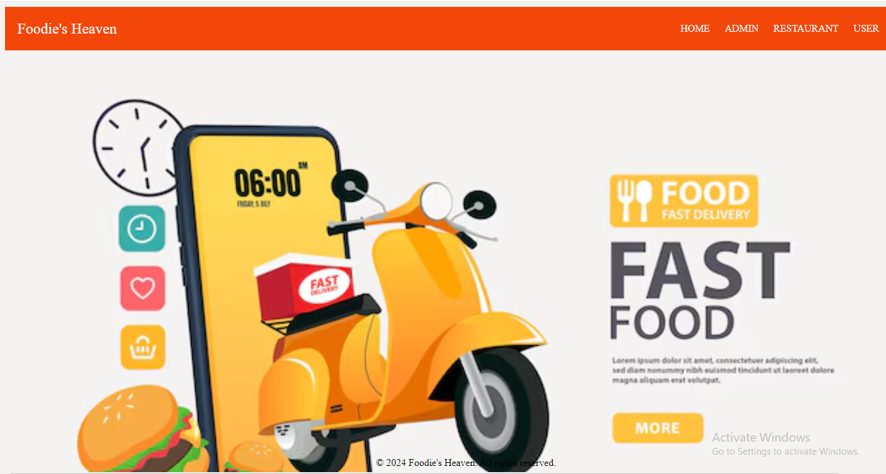
RESULT

Slide 16
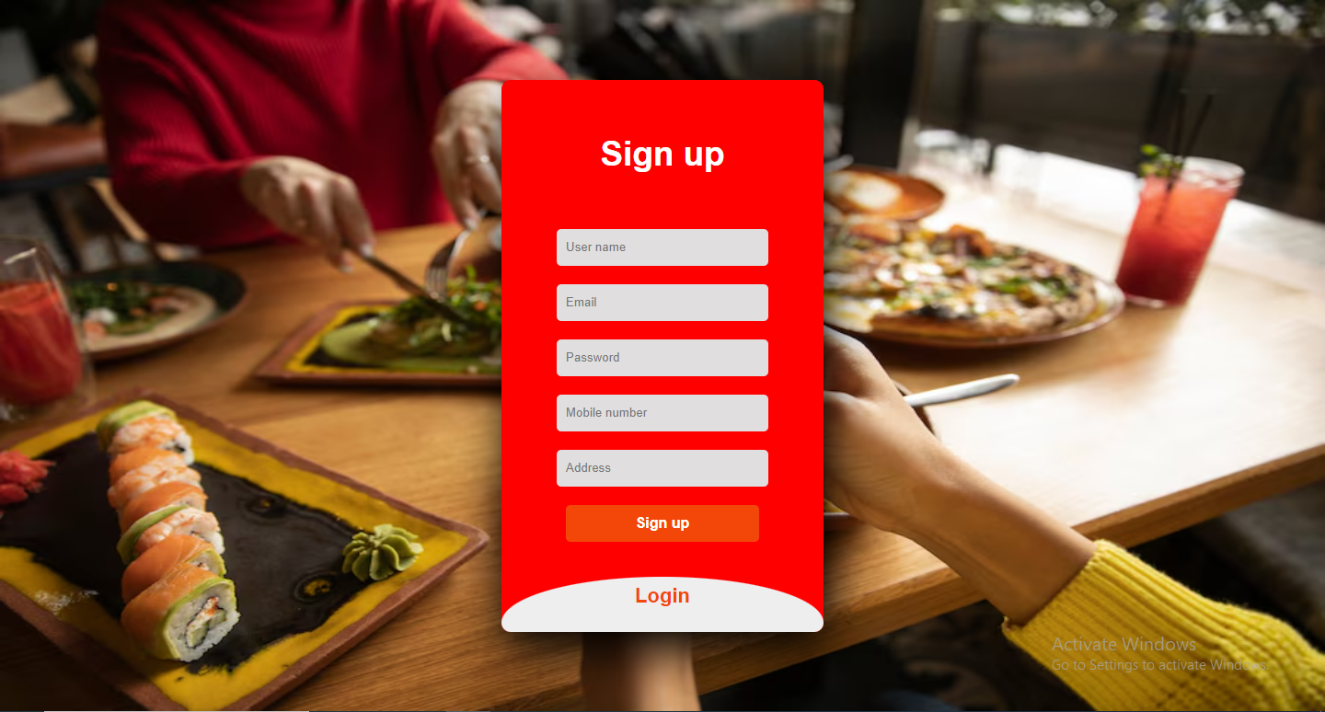
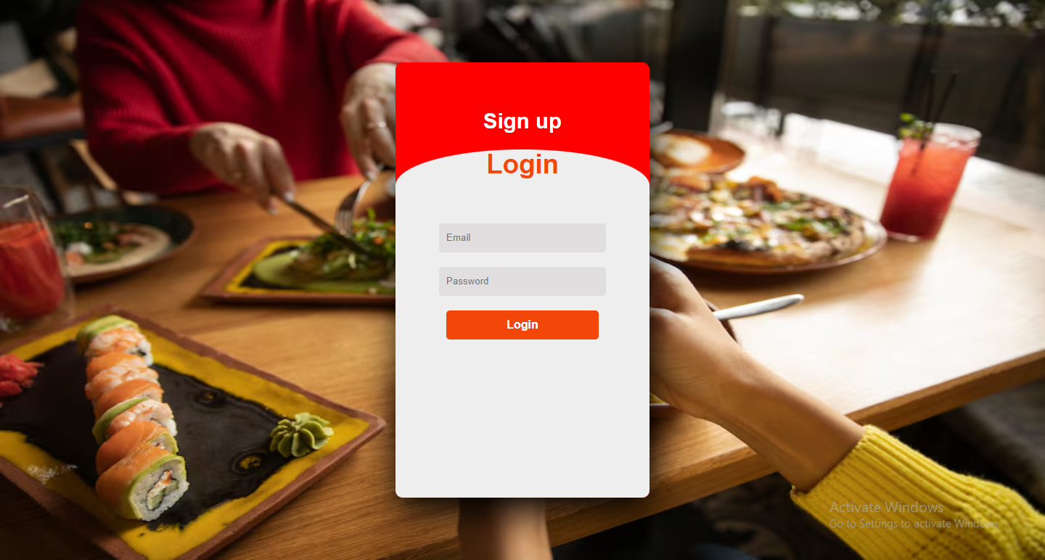
SIGN IN PAGE
LOGIN PAGE

Slide 17
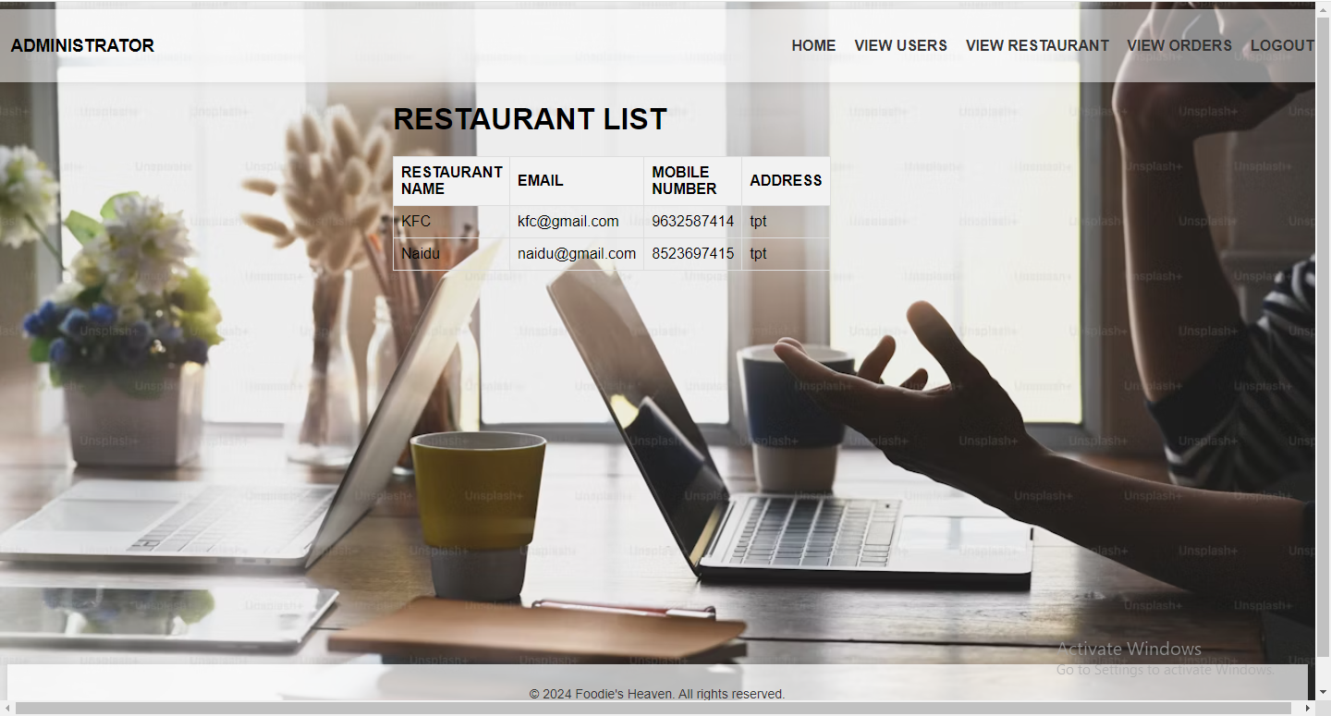
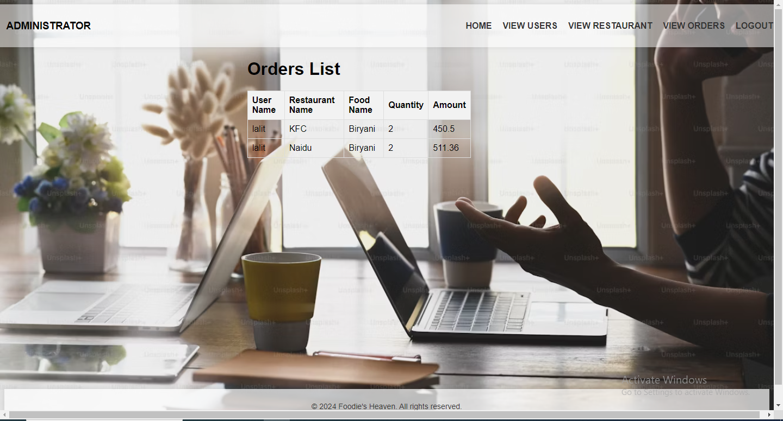
ADMIN’S PHASE
Admin view restaurants:
Admin View Users:

Slide 18
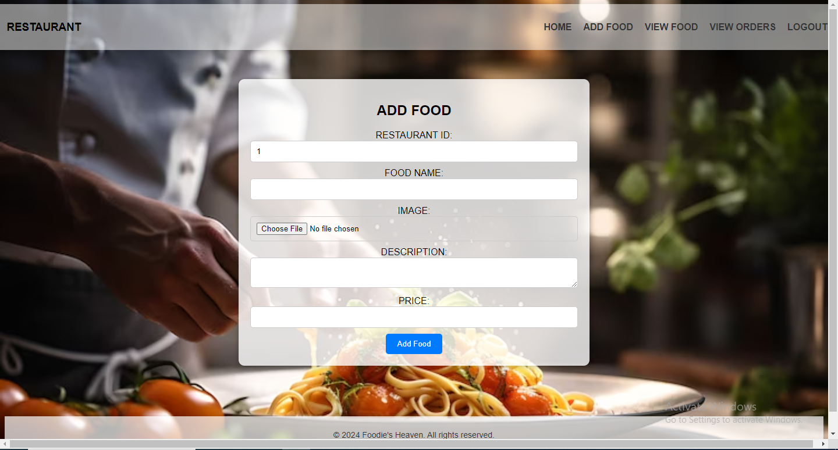
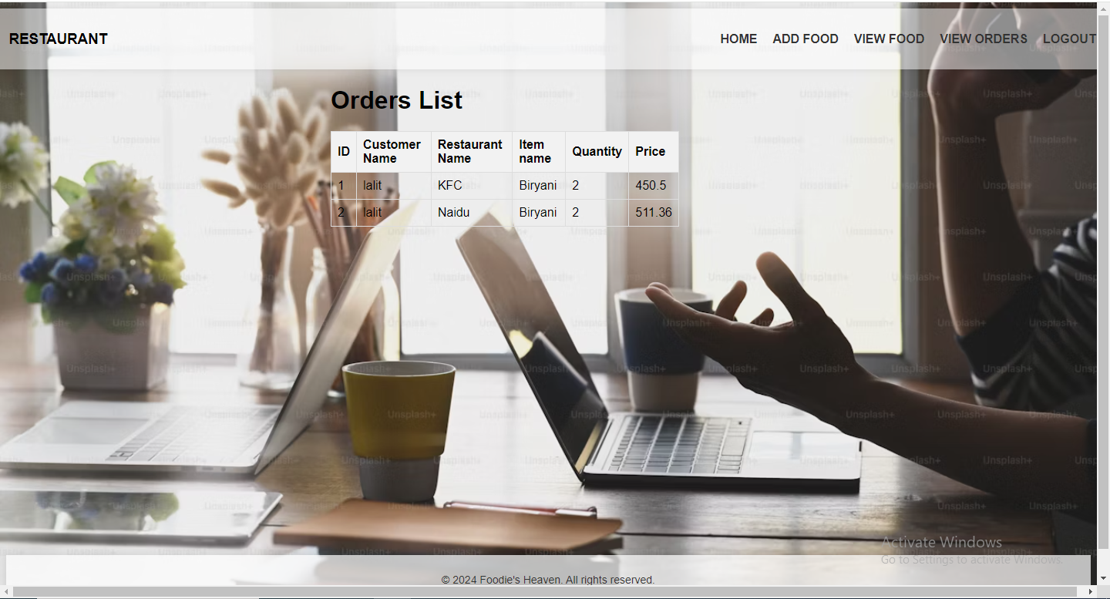
RESTAURANT’S PHASE
Adding Food Items:
Viewing Orders:

Slide 19
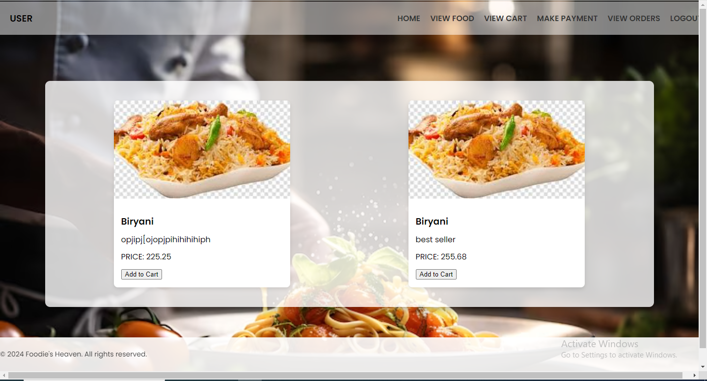
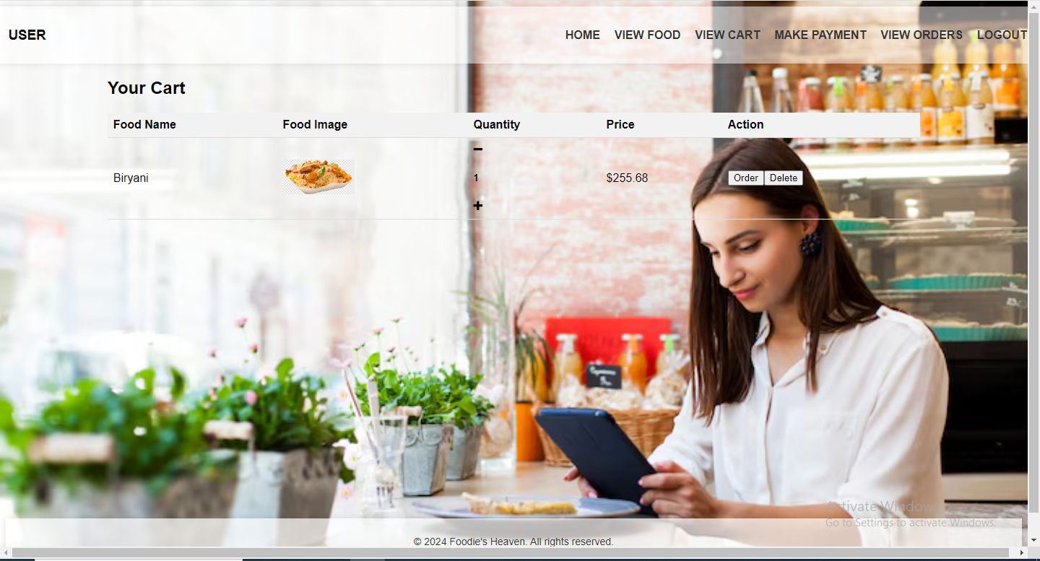
USER’S PHASE
View Food:
View Cart:

Slide 20
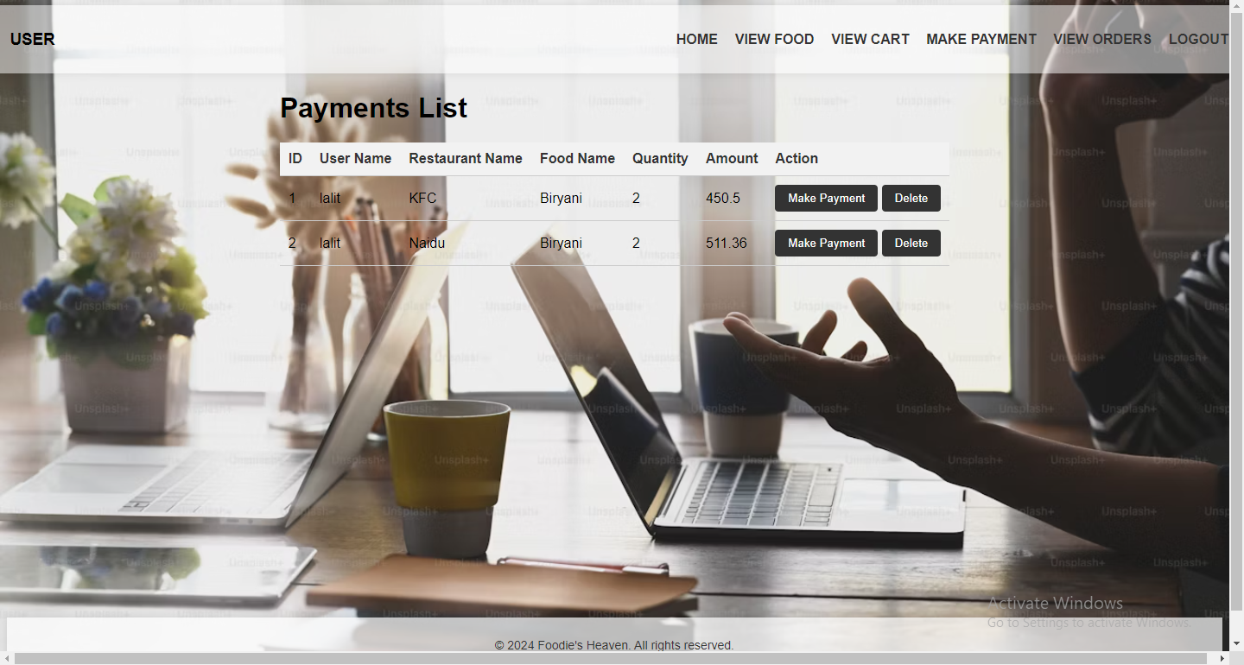
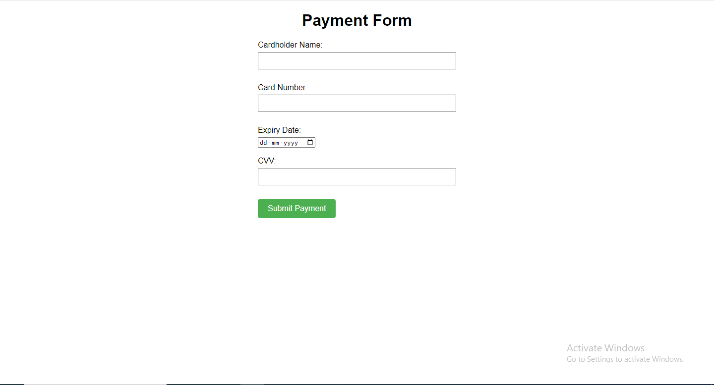
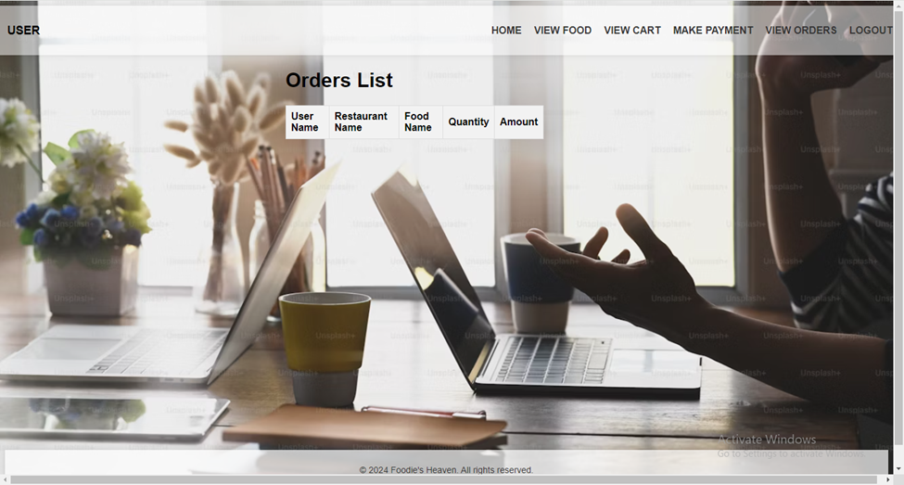
FINAL PHASE
View Orders
Payments
User Orders

Slide 21
CONCLUSION
In conclusion, the Food Order web application offers a user-centric solution to the increasing demand for convenient food ordering and delivery services. By providing a seamless online platform for users to explore menus, place orders, and track deliveries, it enhances the overall dining experience. With its intuitive interface and extensive restaurant options, the application aims to revolutionize the food ordering industry, ensuring customer satisfaction and culinary convenience.

Slide 22
THANK YOU

